Slide 1
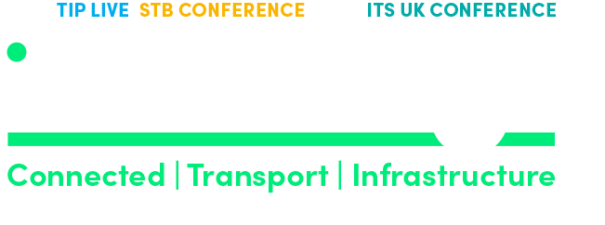
Horizon Scanning
The economy is changing
Carl Waring MSc CEng CITP MBCS MIAM

Slide 2
What is an economy that’s more circular?
It’s a bit like a library – you read something, you take value from it and you put the book back.
This happens again and again for decades.
It is not buying the book, putting it into recycling for it then to be made into an egg carton for 5p.
This LOSS OF VALUE is phenomenal.

Slide 3
You need to think about three things… all at the same time.
What can we do with what we’ve already got?
How do we move from profits from outputs towards profits from outcomes?
How can we be identified from the value we create as being part of a greater whole?
Our future economic value we will not be measured from the outputs we create but from the outcomes we are part of.

Slide 4
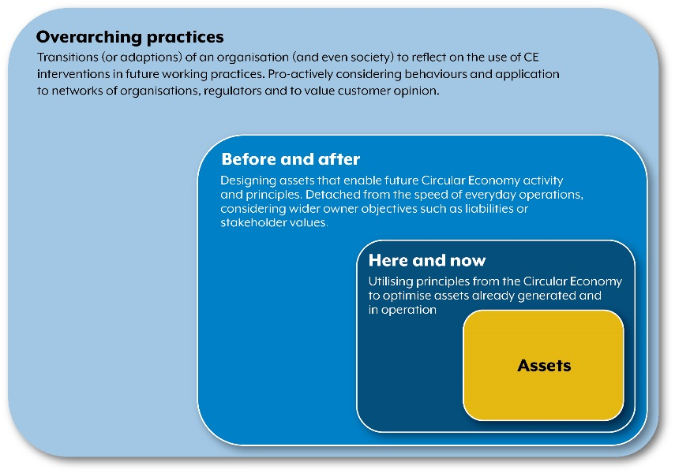
Circular Economy (Asset Management Context)
What can we do differently…?
Continually develop and nurture diverse value streams and capabilities that will sustain the viability of the organisation and the value it creates
How to think about where to start?
You start from three directions all at the same time.
Continuously develop and implement future ready platforms built around viable change.
Exploit what you already have, given you won’t be doing the same in the future

Slide 5
Context why? - We need to change the value of value.
Our economy works around maximising profits over short term horizons.
Resilience and robustness is a product of planning for the medium and long term.
Our economies work on a ‘take-make-waste’ way of working.
Value goes beyond price.
Growth and profits come from increases in consumption.
Behaviours need to change to move from consumption to conserving.
Consequences - a shift in skills, changes in demographics, reduction in know-how, supply chain fragility, leverage in geo-politics and an increase demand for raw materials.
Consequences - Growth in key skills, planned succession, greater effective exploitation of research, balanced supply chains, economic interdependence, reduction in raw materials.
Developing corporate purpose, integrity and identity will become increasingly more important.

Slide 6
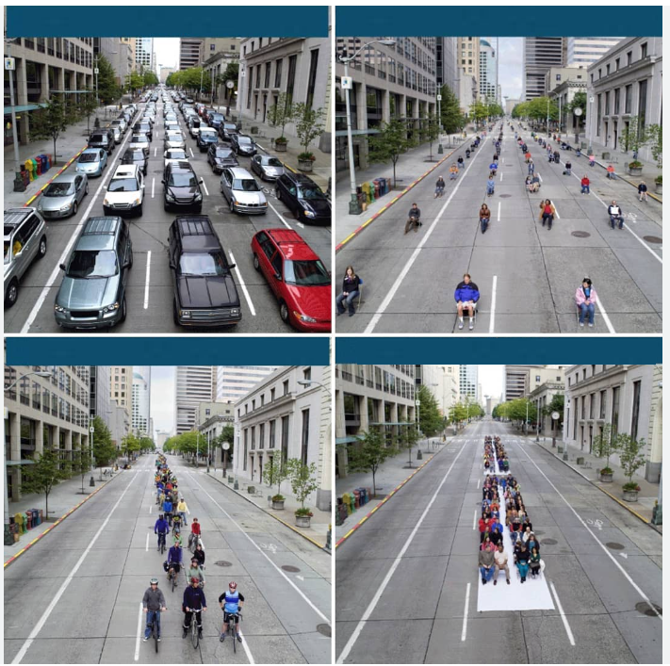
Context why? - We need to change the value of value.
200 people in 177 cars
200 people without their cars
We need to create profit from other types of value.
Developing corporate purpose, integrity and identity will become increasingly more important.
Value Management needs to be continually managed and exploited.
200 people on bikes
200 people on 1 three car train

Slide 7
Context why? - We need to change the value of value.
Emerging external pathways / frameworks:
Emergence of Carbon Accounting,
Environment, Social Governance (ESG),
Sustainable Development Goals (SDG) or…
‘Six Capitals’, the International Integrated Reporting Council (IIRC)
These emerging themes are external to the organisation. None envisages how our future economy will work or how organisations can shape it.
Corporate and economic values need to evolve and adapt rapidly. Just as simple values were created by business in the industrial revolution, businesses should now look to evolve, develop, and adapt more complex values for how the economy will work in the future.

Slide 8
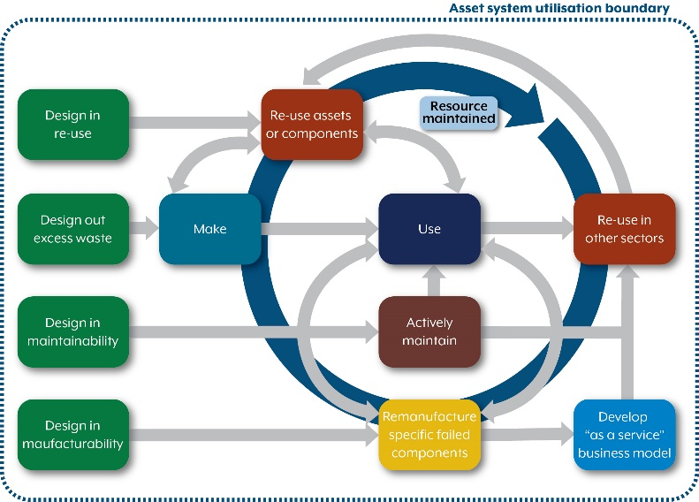
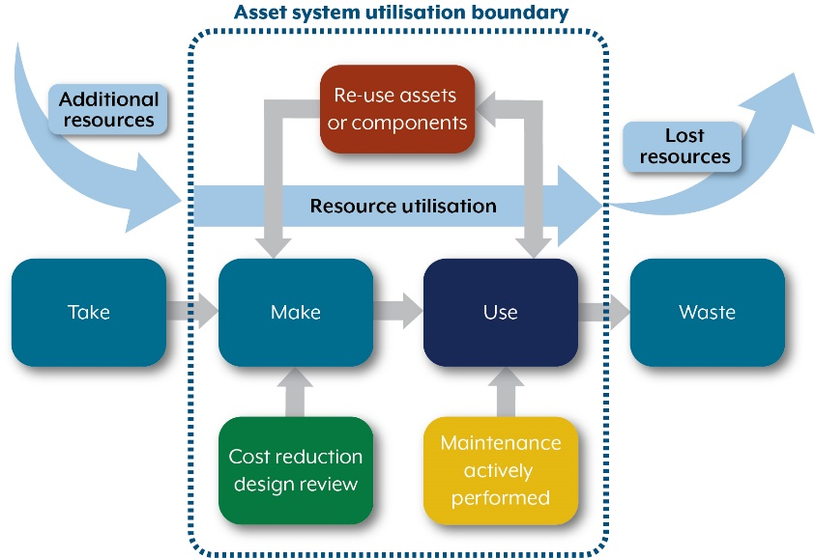
Circular Economy (Asset Management Context)
Not like this
More like this

Slide 9
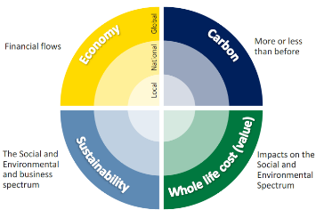
Circular Economy on a page (Asset Management Context)
Profits from outputs towards profits from outcomes
Linear economy – influenced significantly by short term profit gain and minimal compliance to the detriment of externalities.
Circular economy – influenced significantly by creating value that is greater than the sum of its parts with profit.
e.g. Carbon
e.g. ESG
e.g. SDGs etc
Diverse and resilient organisations
Healthy financial flows across those organisations
Value spectrum in context
No evidence of corporate purpose (how value is created, and impact enabled) beyond compliance.
Whole life cost drives increases in consumption.
Driven through efficiencies e.g. in order to maximise short term profit gain.
Beyond Compliance
Evidence of corporate purpose (how value is created beyond the sum of its parts) beyond compliance.
Whole life value frameworks e.g. service orientated.
Driven through performance and effectiveness over the long term.
Continuously emerging value on externalities
External Pathways
Beyond compliance competition horizon

Slide 10
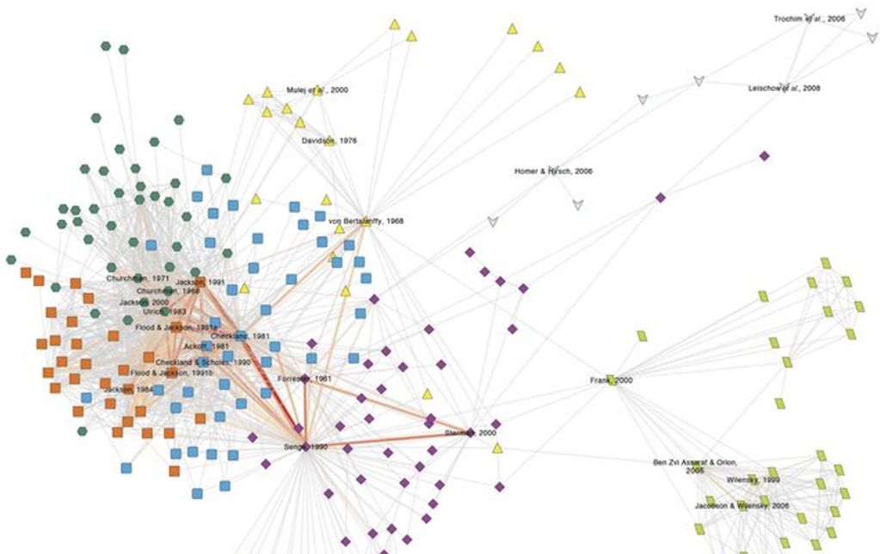
Circular Economy (Asset Management Context)
Conditions of a Circular Economy:
The Prize: Outcomes based
‘where interesting things happen’
Many companies across multiple sectors, different operating models, lots of interactions.
The Products of an economy that’s more circular:
Continuous healthy pipeline of opportunities
Change impacts spread rapidly and adaptations can be made easily.
Not centrally controlled but works on adaptive frameworks.
‘Random’ systems boundaries and evidence of interconnectedness, but not dependent.
Retained history, learning, apprenticeships, culture.
Receptive to change from continuous horizon monitoring
Organisations cover different markets.
Frequent innovation, upgrade/enhanced products.
This is us…

Slide 11
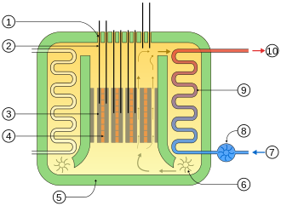
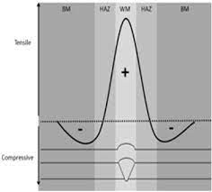
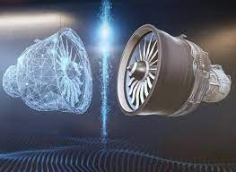
The here and now…
Exploiting advanced research to change the way in which we can extend longer term value.
Gaining intelligence about asset performance to inform opportunities in current and future business operating models.
Notes:
Our fleet of aging AGR Nuclear Power Stations were going to be closed down as original calculations predicted fatigue cracking around welds, yet very few of these cracks were seen in practice. By understanding the post weld residual stress state, we were able to demonstrate to the nuclear regulator, that the predicted cracking would not occur in the proposed extended lifetime of the reactor. This work has saved billions of pounds and played a significant part in our energy security.
Ongoing conflict between rotating machinery OEM’s and end users over the time between service. We run digital twins of gas turbines that monitor critical components in real time. The service life is then fixed to the operating regime of the asset and not just the running hours (assumed to be full power). We gather this intelligence as inputs into future design.

Slide 12
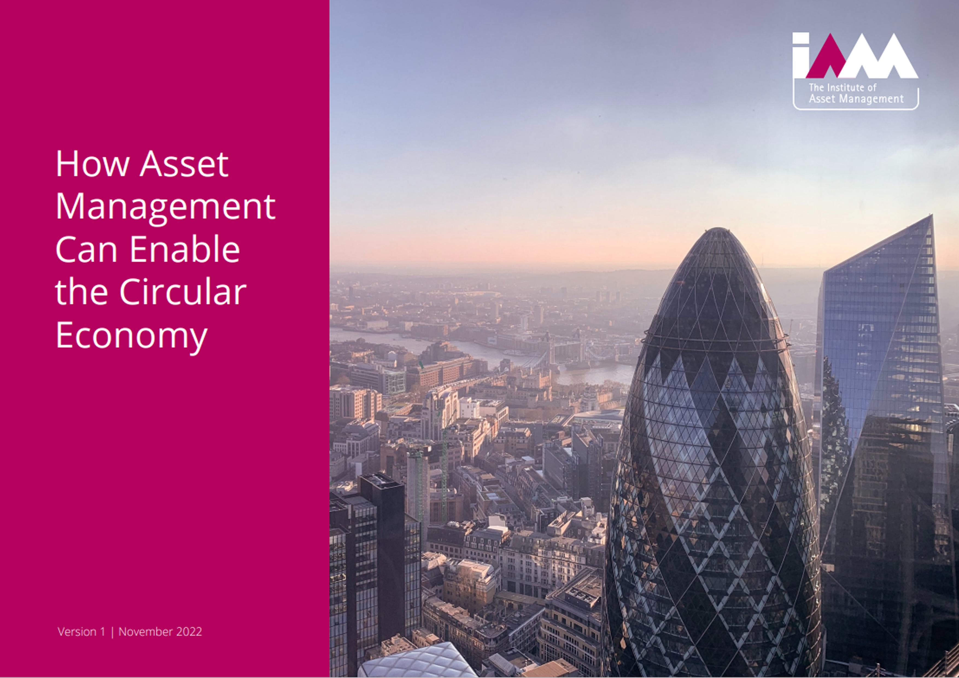
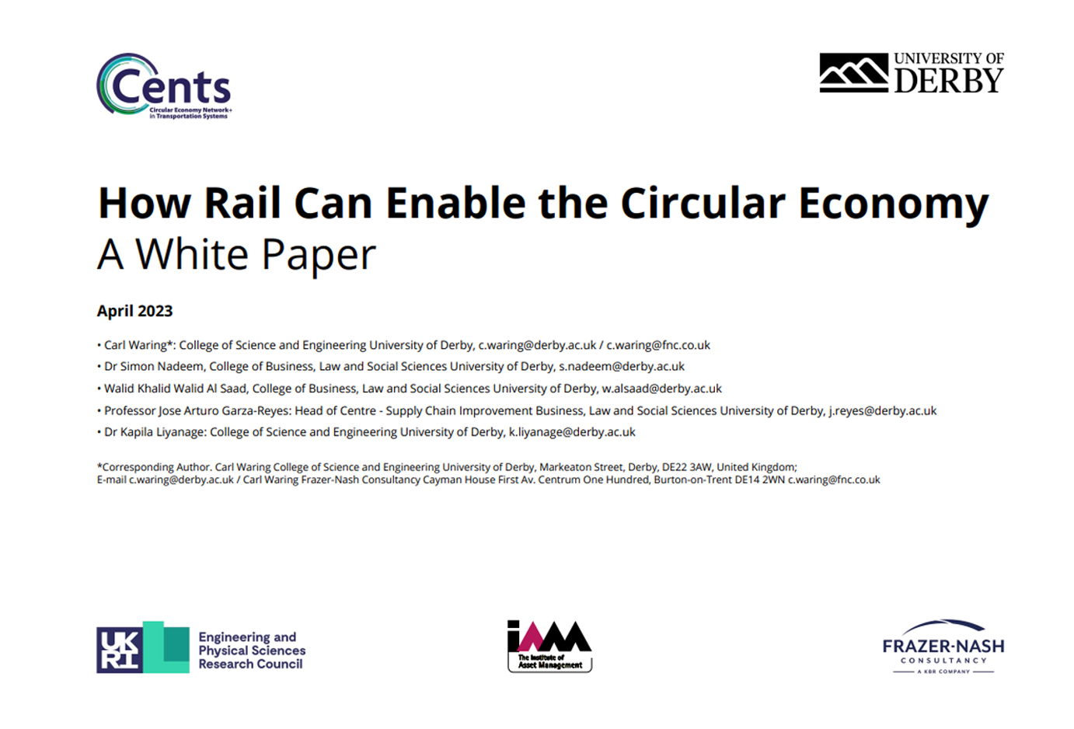
Circular economy white papers:
This white paper aims to outline how asset management can embrace circular economy principles and highlight the opportunities for enhancing value that this can offer.
This is important for organizations working on their circular economy transformation and identity.
Drawing upon good asset management practice, the organization’s leaders and asset managers will need to understand the relative strengths of their existing asset management capability and how these systems can evolve and adapt, supporting a future circular economy.
This white paper is the result of EPSRC/Circular Economy Network for Transportation System (CENTS+) research with the University of Derby and supported by Frazer-Nash.
The white paper is set within the UK rail context and takes a systems thinking view on how the UK railway can align to facilitate growth in the circular economy and how asset management can enable that to happen. As part of the research, a number of workshops were held with rail sector stakeholders.
The paper shows the application and extension to the UK rail sector of the IAM circular economy white paper published in November 2022.
https://theiam.org/knowledge/the-circular-economy/

Slide 13
Thank you

