Slide 1
PAS 2080 and the whole life decarbonisation of infrastructure
Jimmy Richardson

Slide 2
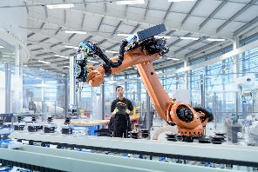
PAS 2080 a framework for change
Notes:
PAS 2080 equips organisations throughout the built environment to accelerate and do better on decarbonisation.
An integrated approach to the built environment – widening the scope of PAS 2080:2016 beyond infrastructure to the built environment
Ways to adopt systems thinking – integrating the transition to net zero into the standard and bringing the rigour and power of systems thinking throughout
A whole-life carbon view – addressing the urgent need to retrofit existing stock and balance capital carbon investment with operational and user benefit
Nature-based solutions - reflecting their value to both carbon reduction and climate change resilience
Collaboration – PAS 2080 highlights the importance of working together across the value chain
Transport infrastructure represents complex supply chains
Compelling need for PAS 2080 to get everyone to pull in the right direction
Good things happening for high carbon insensitive resources – such as steel, concrete and diesel – however, the rate of decarbonisation is not fast enough.

Slide 3
Practical tips for implementing
1. Start somewhere
2. Map stakeholders & collaborate
3. Leadership
4. Embed
5. Continuous improvement

Slide 4
Accelerating action
Access the standard, guidance and support
Challenge and ask
Start somewhere

