Slide 1
Building a new culture - Enhancing collaboration and trust between the Government and the private sector Sara Humber Commercial Specialist IPA

Slide 2
Why are we here?

Slide 3
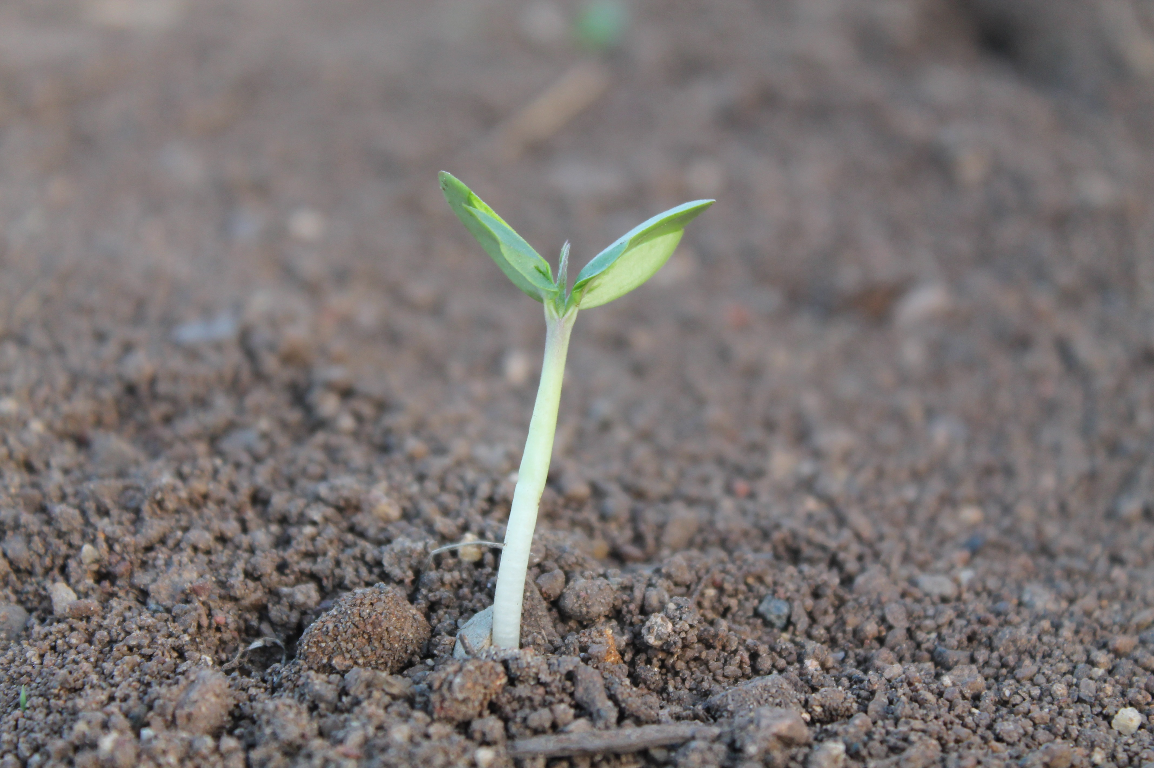
WHY DO I THINK IT IS ABOUT CULTURE?
“Maintain in conditions suitable for growth”

Slide 4
The History
Jan 1994 – Latham report - identifying disharmony recommended a move towards partnering and collaboration between the client and construction business
We are thirty years on and although we have the Construction Playbook, the Sourcing Playbook, Digital, Data and Technology Playbook presumptions in favour of MMC etc etc we appear to be stuck
6: Early supply chain involvement
7: Outcome-based approach

Slide 5
From Uncertainty to Uniformity
Standardisation
Ensures more consistent profiling, smoothing demand cycles
Predictability
Offers clarity on funding allocation timings and amounts
Prioritisation
Focus on the Areas that deliver greatest impact
Innovation
Clear requirements and expectation setting
Efficiency
Enhances resource allocation and project delivery speed

Slide 6
From Distrust to Harmony
Predictable processes mend stakeholder trust, ensuring resource stability
Collaborative environments allow for complex discussions to take place without allocation of blame or liability
But we are caught in a trap….
We can't go on together With suspicious minds And we can't build our dreams On suspicious minds

Slide 7
Business Case Process
At this point RIBA 3 70% of the opportunity of industrialised approach to influence design choices have been lost
Actual cost very different from envelope
Sign contract
Engage people to design it
Procure people to build it
SOC
OBC
FBC
Cost envelope set at the beginning “Anchor”

Slide 8
Modern Business Case Process
Industrialisation decisions made much earlier
Before you start
Group projects together
Standardise
Portfolio manage
Prepare all documentation
Consult on documentation
Create incentivisation strategies
Open book pricing strategies
Encourage the market to feedback in consultation
Prepare to contract over a longer period
Gather data – hone and improve
Be an INTELLIGENT CLIENT
Sign collaborative contract
SOC
OBC
FBC
Procure a strategic alliance with designers, engineers and contractors to inform the SOC and OBC and the cost envelope as it develops

Slide 9
What’s the Problem with changing established processes?
This Photo by Unknown Author is licensed under CC BY-NC

Slide 10
What are the potential benefits from creating the right culture and processes for industrialised solutions to thrive?

Slide 11
The Virtuous Circle
Continuously Improve and repeat
Challenge and change established processes that hinder progress
Establish a culture of mutual respect and trust
Challenge and identify what needs to be improved and hone

Slide 12
Questions?

