Slide 1
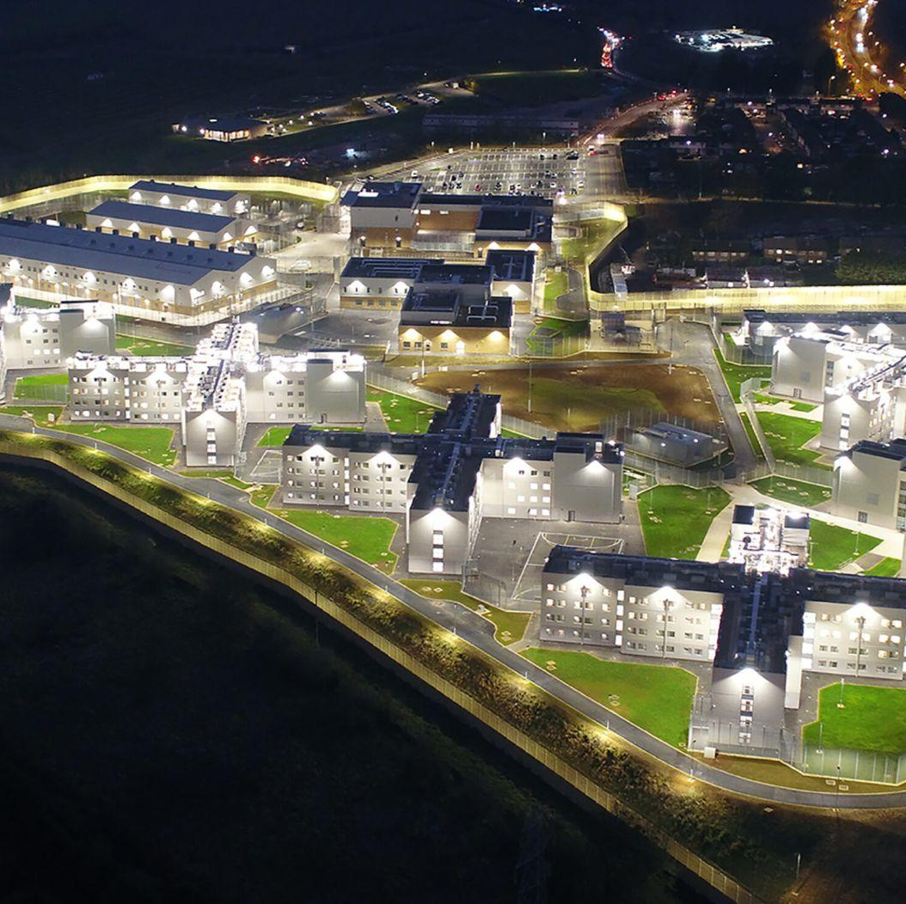
Transforming Infrastructure Performance TIP LIVE 2024
Stephen Dance
Infrastructure and Projects Authority

Slide 2
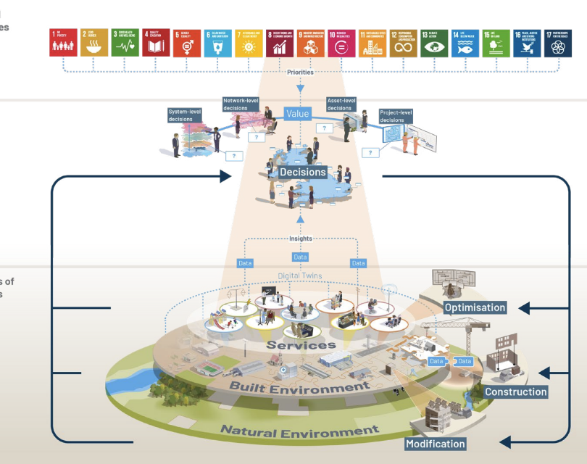
TIP: Building readiness for the future in a challenging environment
Societal outcomes
Policy
Systems of Systems

Slide 3
Value
Industrialisation
Productivity
Our workforce have the right skills to deliver safe products and work in a physically and psychologically safe environment
Strategic plan for maintenance and renewal of UK infrastructure systems with a confident, visible and prioritised pipeline of projects and programmes
Open and shared project data between clients and contractors across sectors
Government, industry and academe have common cause to Transform Infrastructure Performance now and in the future.
Latest BIM technology is required and deployed as a matter of course in all government contracts
Intelligent clients that properly allocate risk and measure contractor performance against financial, environmental and social indicators to incentivise continuous improvement

